Slide 1

Security in Data Management
Presented By Group 17 : Wuang Shen, Zhao Peng, Tiange Wang

Slide 2
About security in data management
Data integrity
Data backup
Access control
Auditing
Authentication
Encryption

Slide 3



Data Integrity - Cause of Integrity Violations
Software or Hardware Error
Malicious Attack
Human Error
http://blog.qatestlab.com/2011/12/06/definitions-and-meaning-error-fault-failure-and-defect/
https://www.deccanchronicle.com/technology/in-other-news/290617/global-cyber-attack-likely-cover-for-malware-installation-in-ukraine.html
https://expertbeacon.com/how-approach-data-deletion-your-records-management-policy/#.Ws2en2Qza8U

Slide 4

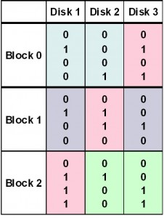
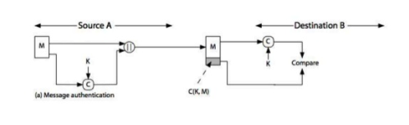
Data Integrity - Verification methods
Mirroring
Check Summing
RAID Parity
https://blog.rocketsoftware.com/2015/06/why-mirroring-alone-falls-short-for-adequate-data-protection/#.Ws2bXWQza8U
https://www.slideshare.net/sid15/hash-function-33408341
http://www.datlabsdatarecovery.co.uk/raid-5-data-recovery/

Slide 5
Data Backup
Potential issues to data mangemnet without backup:
Malicious Attack
Physical Disasters
Different type of backup:
Online Backup vs Offline Backup
Full Backup vs Incrfemental Backup

Slide 6
Access Control
The selective restriction of access to a database or other resource
Two main models:
Discretionary access control
Mandatory access control

Slide 7
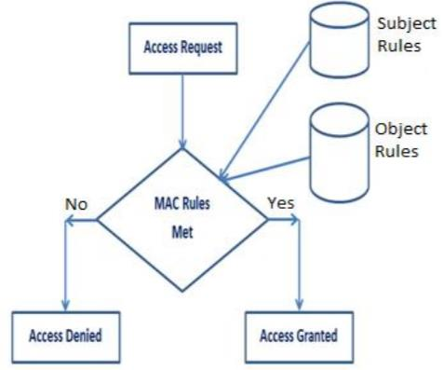
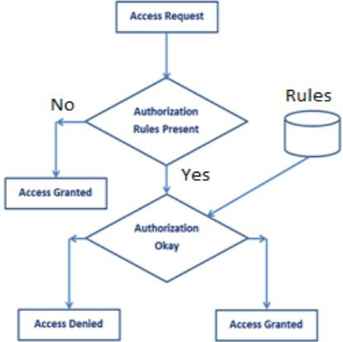
Access Control
Discretionary Access Control (DAC)
The owner of the object specifies which subjects can access the object
Mandatory Access Control (MAC)
Constrains the ability of a subject to access or perform operations on an object.

Slide 8
Auditing
The monitoring and recording of the selected user database action. it can be based on individual actions, such as of the type of SQL statement executed.
Purpose:
investigate suspicous activities
monitor and analyze the database activities
keep track of changes
detect and analyze user behavior

Slide 9
Auditing
Auditing techniques
Trace-based auditing
built directly into the native capacity of DBMS
Scan and Parse the database transaction logs
use transaction logs to capture database modification

Slide 10
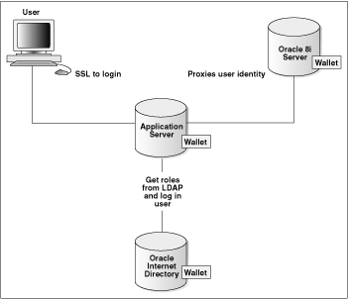
Authentication
Confirm the identities of users:
key
encryption algorithm
biological features
Issues:
Unauthorized users access the database
Source: https://docs.oracle.com/cd/B19306_01/network.102/b14266/authmeth.htm

Slide 11
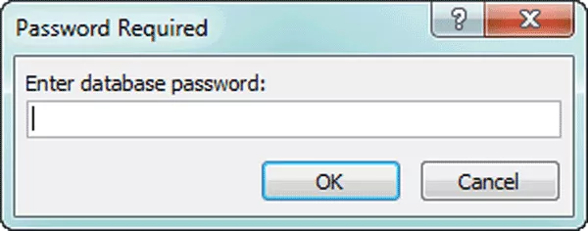
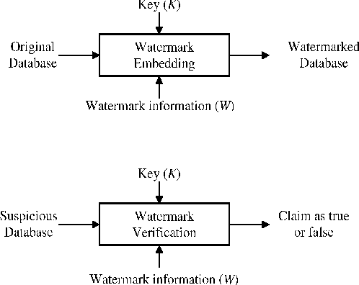
Authentication
Password:
provide fundamental authentication
vulnerable to theft and misuse
weak passwords may attract attacks
Watermarking:
difficult to remove
do not modify database items
rely on the primary key
Source: http://accesshosting.com/decrypt-ms-access-database
Source: https://www.semanticscholar.org/paper/Watermarking-Techniques-for-Relational-Databases%3A-Halder-Pal/7a3e3828ad3c240ba5ce50b5b660777a15a4f04c

Slide 12
Encryption
Transform data into ciphertext
Protect data from being accessed by unauthrized users.
Issues:
Once attckers obtain the authority, they could theft/read/modify data directly.

Slide 13
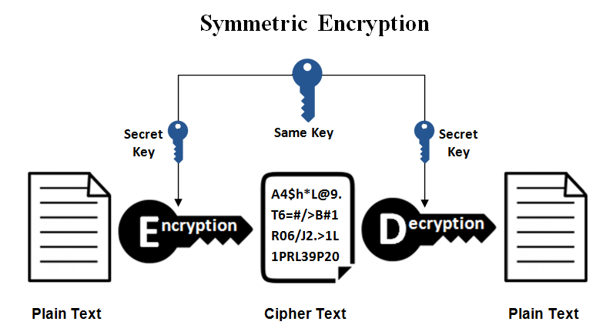
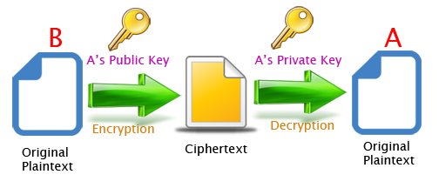
Encryption
Symmetric:
secret key (DES)
fast operation speed and efficiency
Asymmetric:
public key and private key
high level security
high cost
Source: https://www.ssl2buy.com/wiki/symmetric-vs-asymmetric-encryption-what-are-differences
Source:
http://www.giuseppeurso.eu/en/asymmetric-rsa-encryption-in-java/

Slide 14

Data integrity
Data backup
Access control
Auditing
Authentication
Encryption

Slide 15
Reference list
Akhtar, A., Buchholtz, J., Ryan, M. and Setty, K. (2012). Database Backup and Recovery Best Practices. ISACA Journal, 1.
Akshay Patil, Prof. B. B. Meshram. (2012) Database Access Control Policies. Database Access Control Policies. International Journal of Engineering Research and Applications (IJERA). pp.3150-3154
Anon, (2003). 4 Authenticating Users to the Database. [online] Available at: https://docs.oracle.com/cd/B14117_01/network.101/b10777/authuser.htm.
Ausanka-Crues, R. (2001). Methods for access control: advances and limitations. Harvey Mudd College, 20, p.301.
Docs.oracle.com. (2018). Database Auditing: Security Considerations. [online] Available at: https://docs.oracle.com/cd/B19306_01/network.102/b14266/auditing.htm#CHDJBDHJ
Shelar, P., Patil, P., Khamkar, A., Patil, A., Malavi, T. and Parabkar, N. (2016). Database Security using Watermarking Technique. International Research Journal of Engineering and Technology (IRJET), 03(05).
Shmueli, E., Vaisenberg, R., Elovici, Y. and Glezer, C. (2010). Database encryption. ACM SIGMOD Record, 38(3), p.29.
Sivathanu, G., Wright, C.P. and Zadok, E. (2005) Ensuring data integrity in storage: techniques and applications, Proceedings of the 2005 ACM workshop on Storage security and survivability. pp.26-36

